Slide 1
CS 371
Artificial Intelligence
Fall 2023
Course Credits: Stanford-CS221

Slide 2


Slide 3
Why Artificial Intelligence?

Slide 4
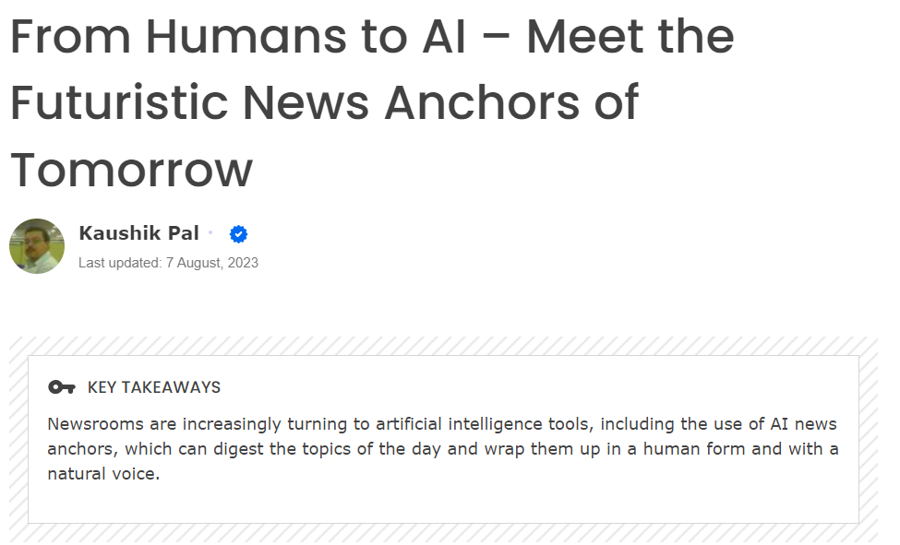

Slide 5
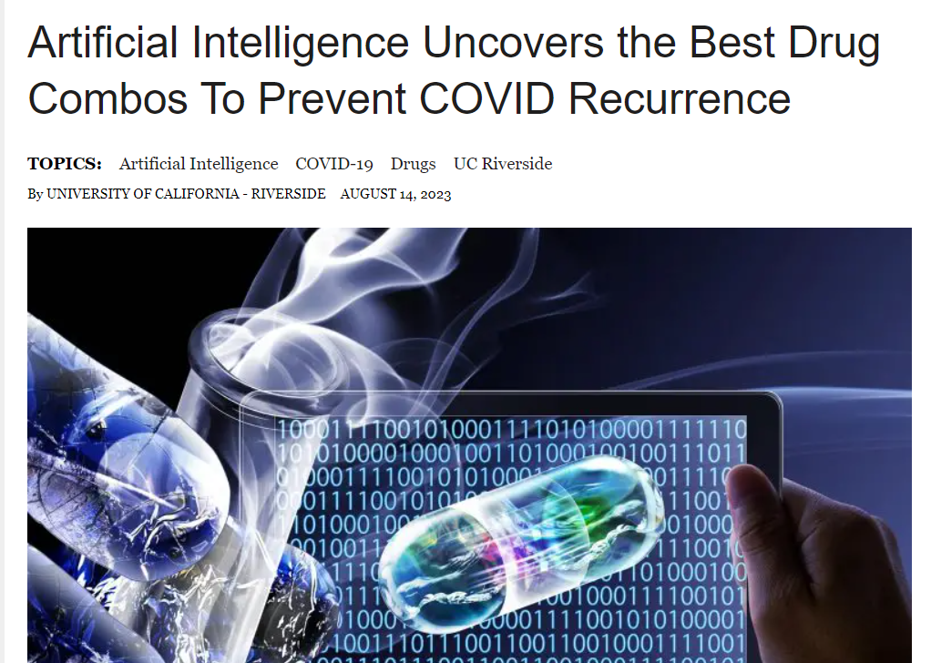

Slide 6
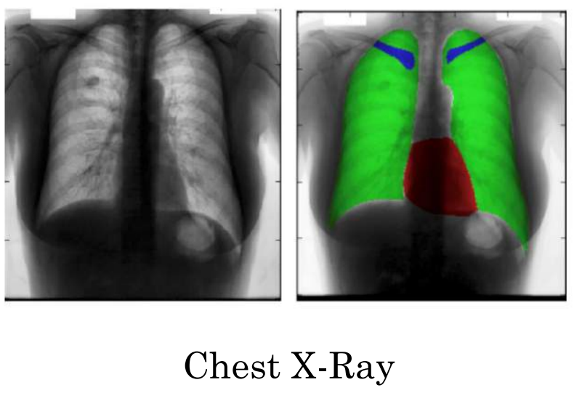
AI for Healthcare

Slide 7
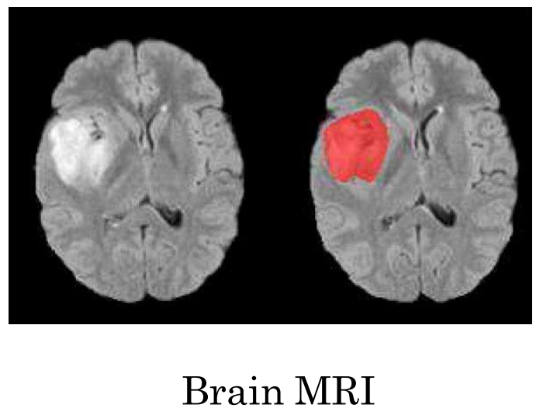
AI for Healthcare

Slide 8
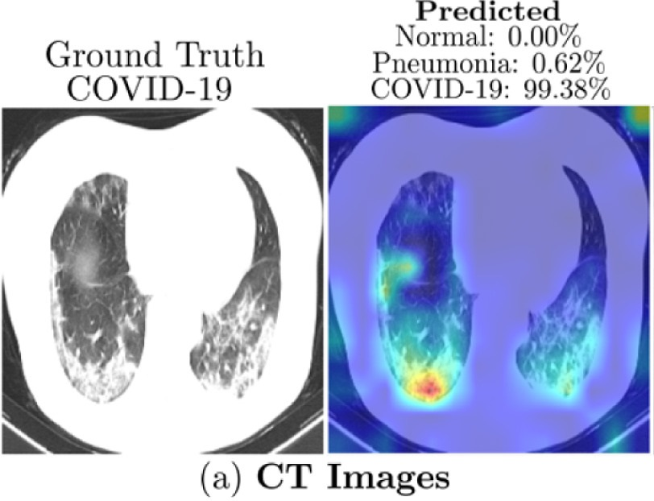
AI for Healthcare

Slide 9
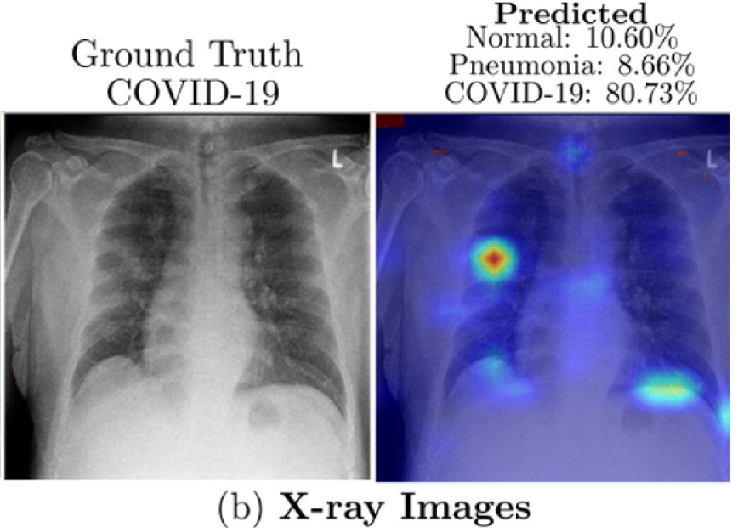
AI for Healthcare

Slide 10
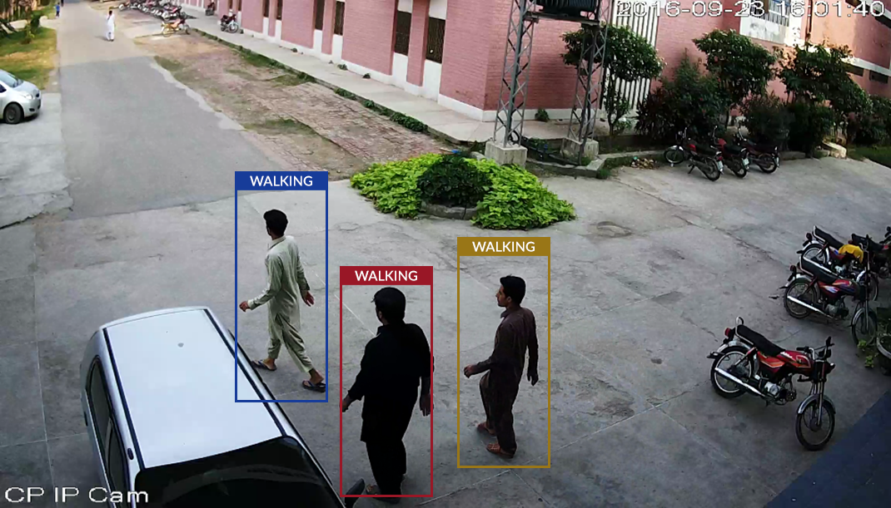
AI for Surveillance (activity monitoring

Slide 11
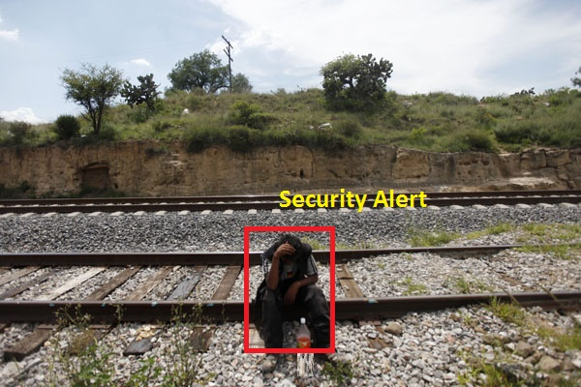
AI for Surveillance (Threat alerts)

Slide 12

AI for Surveillance
(crowed sourcing: mobs, protests)

Slide 13
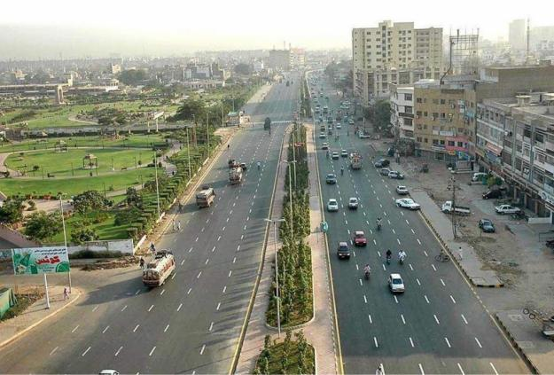
AI for Surveillance
(over speeding, signals violations, safe cities, non standard no plates, lane violation, etc.)

Slide 14
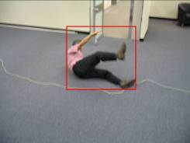
AI for Surveillance
(violence, suicides, snatching, harassments, fighting, elderly people care, baby care, etc.)

Slide 15
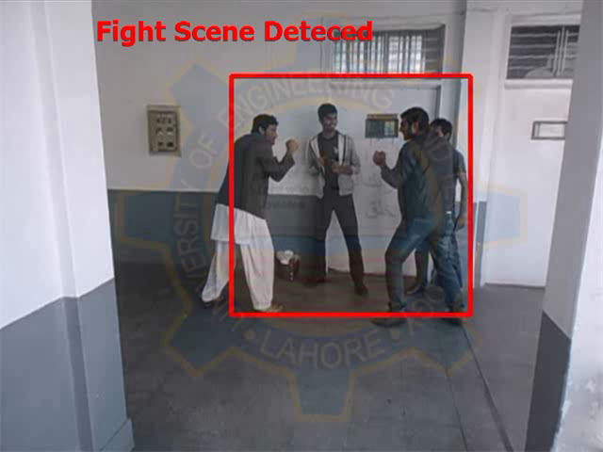
AI for Surveillance

Slide 16
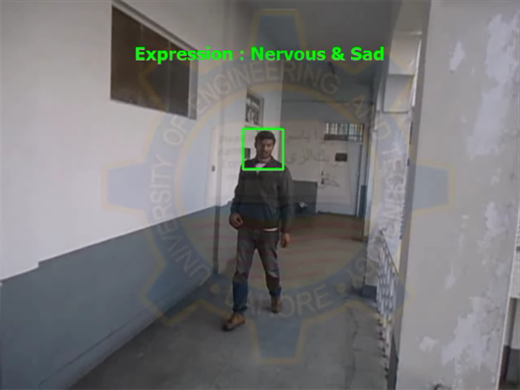
AI for Surveillance

Slide 17
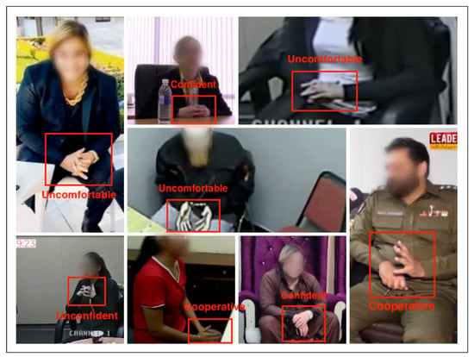
AI for Surveillance

Slide 18
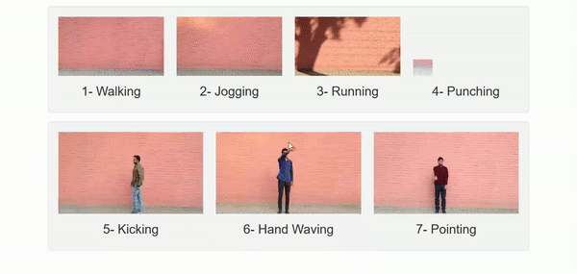
AI for Surveillance (Activity monitoring

Slide 19
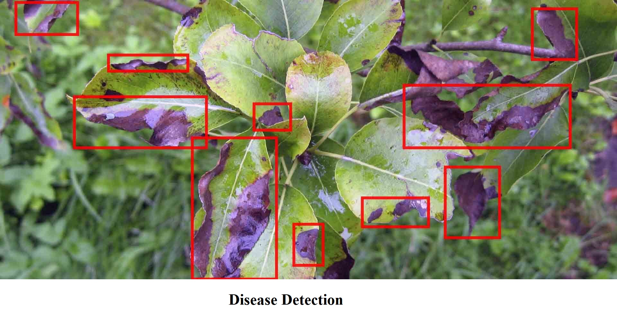
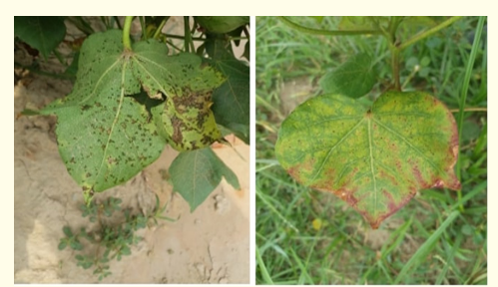
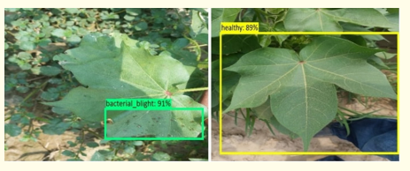
AI for Agriculture

Slide 20


AI for Health
https://ieeexplore.ieee.org/abstract/document/5699181
E-SEHAT (Smart Healthcare System for preliminary Diagnostic and Remote Consultancy)

Slide 21
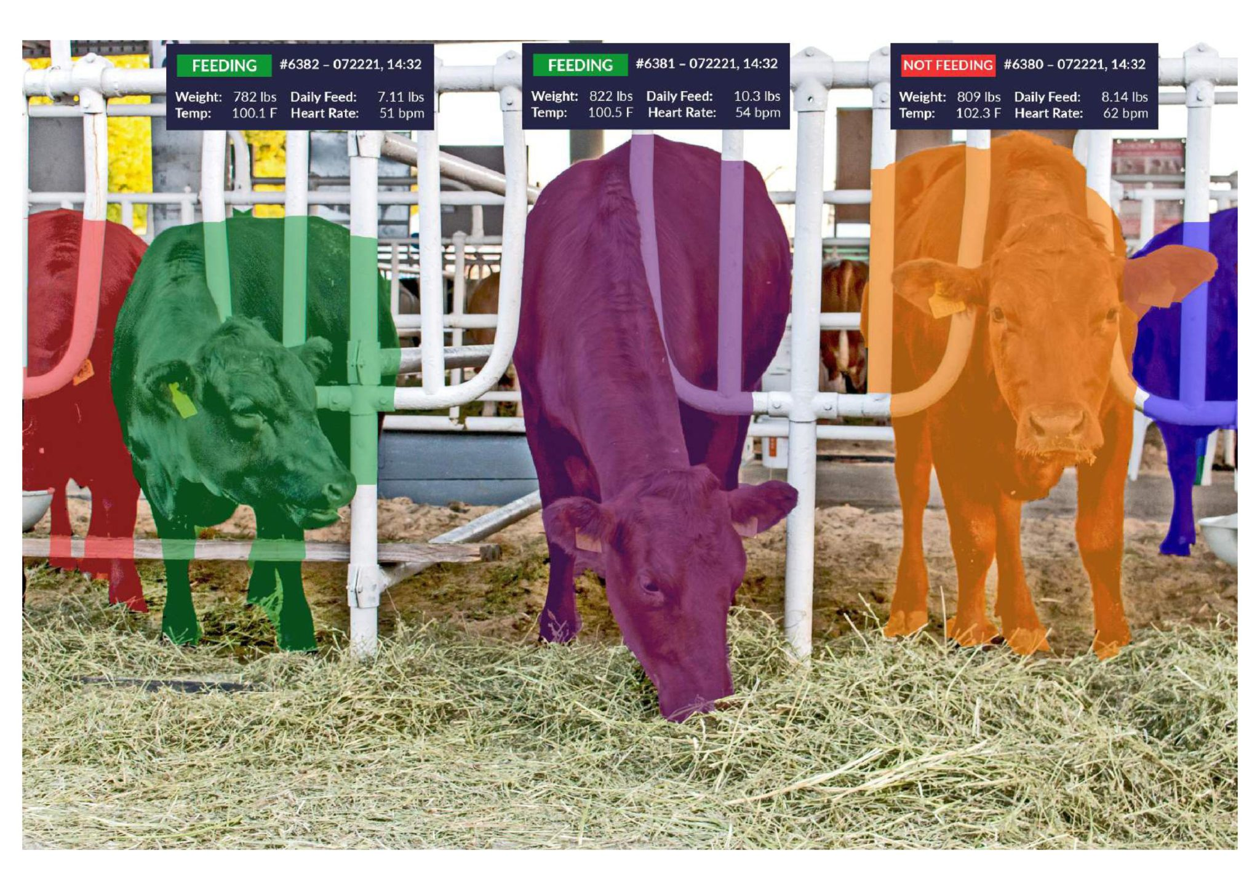
AI for Livestock

Slide 22
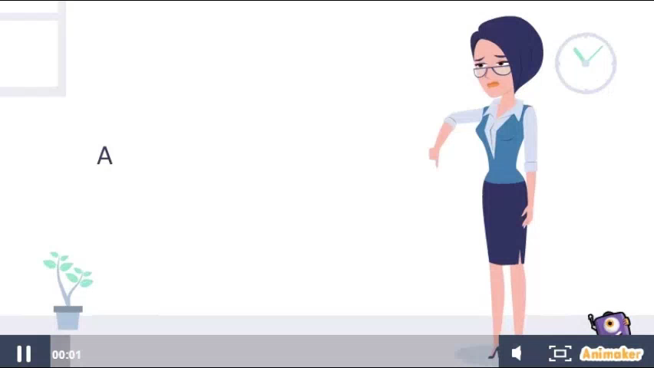
AI for Education

Slide 23
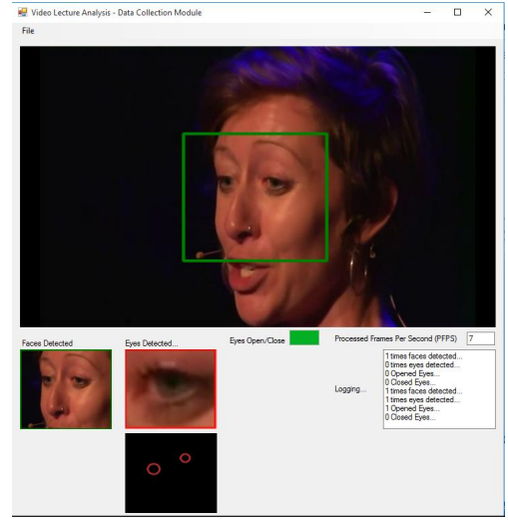
AI for Education
PACA-ITS: A Multi-Agent System
for Intelligent Virtual Laboratory
Courses

Slide 24
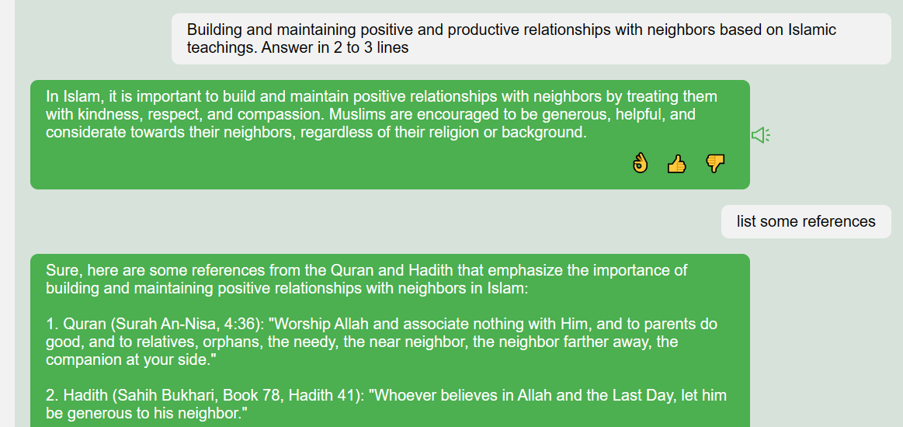
AI for Religion

Slide 25
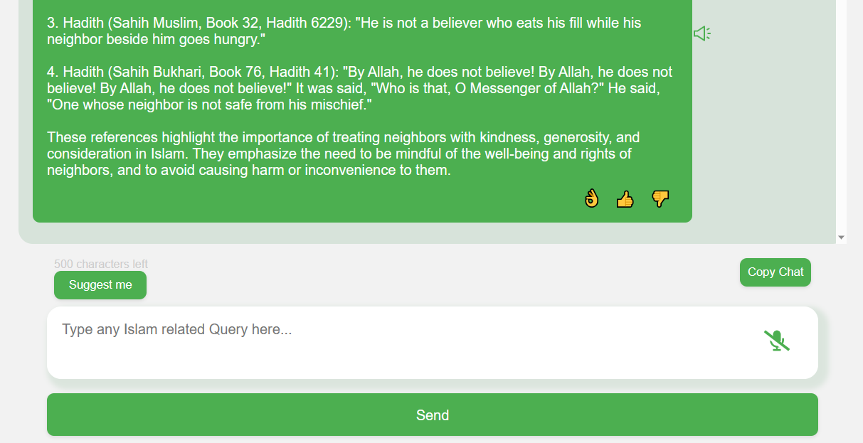
AI for Religion

Slide 26

AI for Commerce > Einstein GPT

Slide 27

AI for Commerce > Octane AI

Slide 28
What is Artificial Intelligence?

Slide 29

Brain and AI..

Slide 30
Knowledge Quotes
“The development of full artificial intelligence could spell the end of the human race”
(Prof. Stephen Hawking’s sentiment in a BBC interview, December 2014)
“Artificial Intelligence is the new electricity” (Andrew Ng)
“Will robots inherit the earth?” Yes, but they will be our children (Marvin Minsky)
Full artificial intelligence – Artificial General Intelligence (AGI)
”the intelligence of a machine that could successfully perform any intellectual task that a human being can.”

Slide 31
AI Meaning
“Artificial Intelligence is the science of making machines do things that would require intelligence if done by men” (Marvin Minsky)

Slide 32
Artificial Intelligence is…
The study of the computations that make it possible to perceive, reason, and act…
Different from psychology
Different from computer science

Slide 33
History of Artificial Intelligence?

Slide 34
Muslim Golden Age 2.0
Concept of Algorithms by Muhammad al-Khwarizmi
Foundation for the Robotics (The ‘Book of Ingenious Devices’ by Banu Musa)
Astrolabe (Mariam al-Astrulabi)
Early programmable humanoid robot in 1206 and Elephant Clock by Aljazari

Slide 35
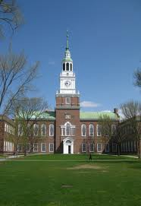
Birth of Modern AI
1956: Workshop at Dartmouth College; attendees: John McCarthy, Mar- vin Minsky, Claude Shannon, etc.
Aim for general principles:
  Every aspect of learning or any other feature of intelligence can be so precisely described that a machine can be made to simulate it.
Notes:
How did we get here? The name artifical intelligence goes back to a summer in 1956. John McCarthy, who was then at MIT but later founded the Stanford AI lab, organized a workshop at Dartmouth College with the leading thinkers of the time, and set out a very bold proposal...to build a system that could do it all.

Slide 36
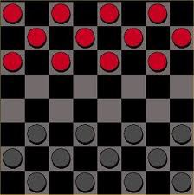

Birth of AI, early successes
Checkers (1952)
  Samuel’s program learned weights and played at strong amateur level, which move is more beneficial?
Problem solving (1955)
  Newell & Simon’s Logic Theorist: prove theorems in Principia Mathematica using search + heuristics; later, General Problem Solver (GPS), best possible solution, CSP problems, etc
Notes:
While they did not solve it all, there were a lot of interesting programs that were created: programs that could play checkers at a strong amateur level, programs that could prove theorems.
For one theorem Newell and Simon’s Logical Theorist actually found a proof that was more elegant than what a human came up with. They actually tried to publish a paper on it but it got rejected because it was not a new theorem; perhaps they failed to realize that the third author was a computer program.
From the beginning, people like John McCarthy sought generality, thinking of how commonsense reasoning
could be encoded in logic. Newell and Simon’s General Problem Solver promised to solve any problem (which could be suitably encoded in logic).

Slide 37
Overwhelming optimism...
Machines will be capable, within twenty years, of doing any work a man can do. —Herbert Simon
Within 10 years the problems of artificial intelligence will be substantially solved. —Marvin Minsky
I visualize a time when we will be to robots what dogs are to humans, and I’m rooting for the machines. — Claude Shannon
Notes:
It was a time of high optimism, with all the leaders of the field, all impressive thinkers, predicting that AI would be ”solved” in a matter of years.

Slide 38
...underwhelming results
Example: Machine translation
The spirit is willing but the flesh is weak.
(Russian)
The vodka is good but the meat is rotten.
1966: ALPAC report cut off government funding for MT, first AI winter

Slide 39

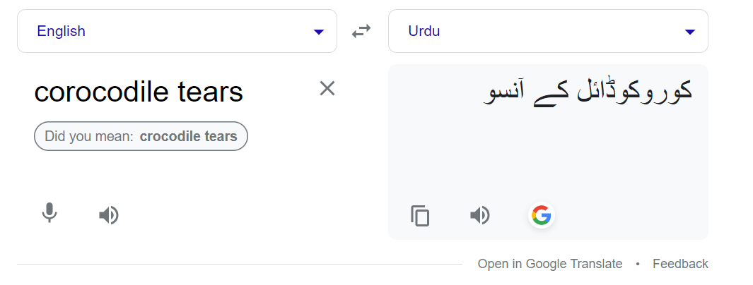
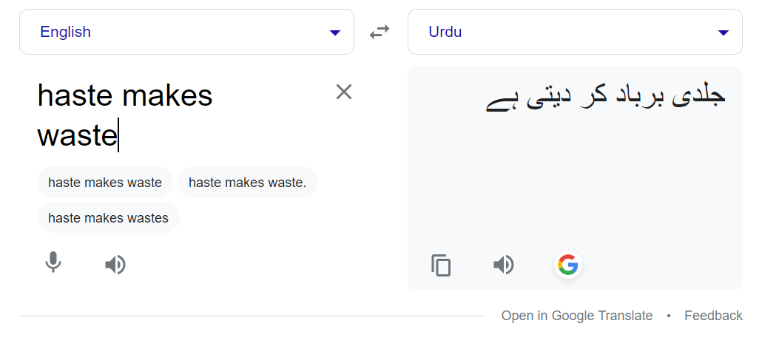
Latest issues in Machine translation

Slide 40
Implications of early era
Problems:
  Limited computation: search space grew exponentially, outpacing hardware (100! ≈ 10157 > 1080)
  Limited information: complexity of AI problems (number of words, objects, concepts in the world)
Contributions:
  Lisp, garbage collection, time-sharing (John McCarthy)
  Key paradigm: separate modeling and inference
Notes:
What went wrong? It turns out that the real world is very complex and most AI problems require a lot of
compute and data.
The hardware at the time was simply too limited both compared to the human brain and computers available now. Also, casting problems as general logical reasoning meant that the approaches fell prey to the exponential search space, which no possible amount of compute could really fix.
Even if you had infinite compute, AI would not be solved. There are simply too many words, objects, and
concepts in the world, and this information has to be somehow encoded in the AI system.
Though AI was not solved, a few generally useful technologies came out of the effort, such as Lisp (still the world’s most advanced programming language in a sense).
One particularly powerful paradigm is the separation between what you want to compute (modeling) and how to compute it (inference).

Slide 41

Knowledge-based systems (70-80s)
Expert systems: elicit specific domain knowledge from experts in form of rules:
if [premises] then [conclusion]
Notes:
In the seventies and eighties, AI researchers looked to knowledge as a way to combat both the limited computation and information problems. If we could only figure out a way to encode prior knowledge in these systems, then they would have the necessary information and also have to do less compute.

Slide 42
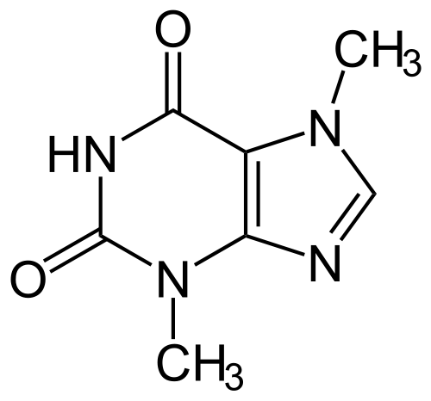

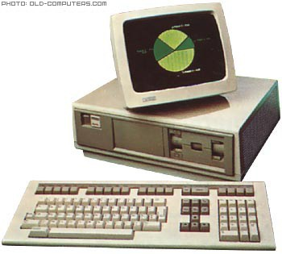
Knowledge-based systems (70-80s)
DENDRAL: infer molecular structure from mass spectrometry
MYCIN: diagnose blood infections, recommend antibiotics
XCON: convert customer orders into parts specification; save DEC $40 million a year by 1986
Notes:
Instead of the solve-it-all optimism from the 1950s, researchers focused on building narrow practical systems in targeted domains. These became known as expert systems.

Slide 43
Knowledge-based systems
Contributions:
  First real application that impacted industry
  Knowledge helped curb the exponential growth
  Rules-based systems are generally lower effort, more cost-effective and less risky since these rules won’t change or update on their own.
  “fixed” intelligence.
Problems:
  Knowledge is not deterministic rules, need to model uncertainty
  Requires considerable manual effort to create rules, hard to maintain
  Rules can limit AI capabilities with rigid intelligence that can only do what they’ve been written to do.
1987: Collapse of Lisp machines and second AI winter
We need more adaptive
Systems that can learn from
data
Where to choose RB systems:
Fixed out comes, minimum risk
More effective, no ML planning
Notes:
This was the first time AI had a measurable impact on industry. However, the technology ran into limitations and failed to scale up to more complex problems. Due to plenty of overpromising and underdelivering, the field collapsed again.
We know that this is not the end of the AI story, but actually it is not the beginning. There is another thread for which we need to go back to 1943.

Slide 44
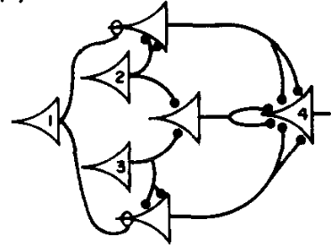
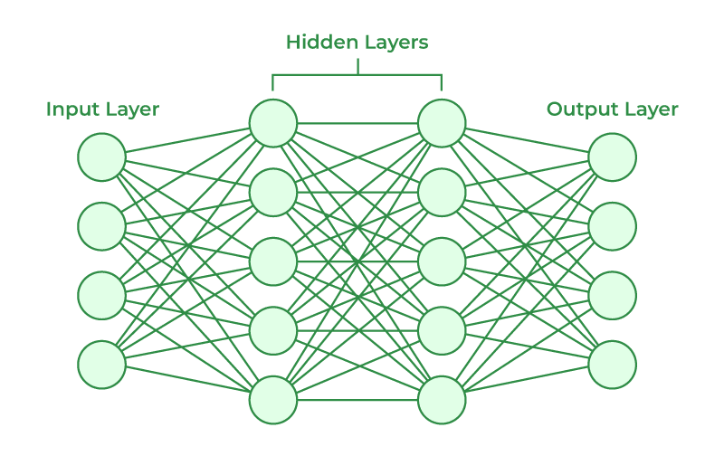

Artificial neural networks
1943: introduced artificial neural networks, connect neural circuitry and logic (McCulloch/Pitts)
1969: Perceptrons book showed that linear models could not solve XOR, killed neural nets research (Min- sky/Papert)
Notes:
Much of AI’s history was dominated by the logical tradition, but there was another smaller camp, grounded in neural networks inspired by the brain.
(Artificial) neural networks were introduced by a famous paper by McCulloch and Pitts, who devised a simple mathematical model and showed how it could be be used to compute arbitrary logical functions.
Much of the early work was on understanding the mathematical properties of these networks, since com- puters were too weak to do anything interesting.
In 1969, a book was published that explored many mathematical properties of Perceptrons (linear models) and showed that they could not solve some simple problems such as XOR. Even though this result says nothing about the capabilities of deeper networks, the book is largely credited with the demise of neural networks research, and the continued rise of logical AI.

Slide 45
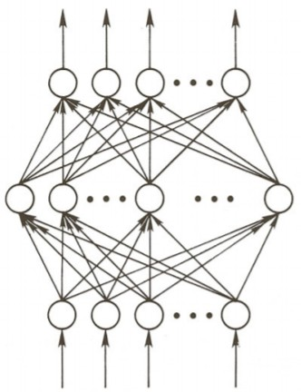
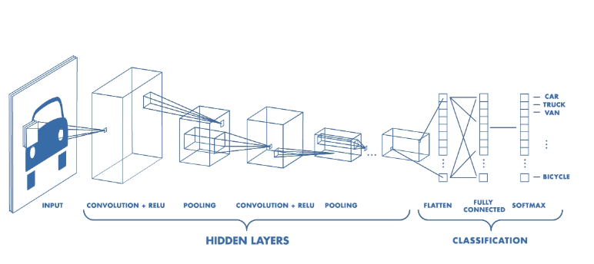
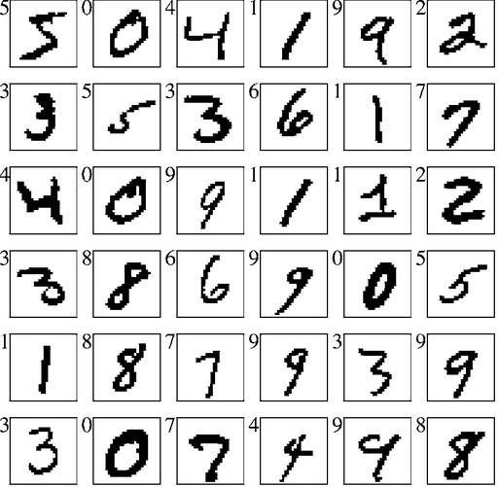
Training networks
1986: popularization of backpropagation for training multi-layer networks (Rumelhardt, Hinton, Williams)
1989: applied convolutional neural networks to recognizing handwritten digits for USPS (LeCun)
CNN is a class of neural networks that specializes in processing data that has a grid-like topology, such as an image.
A CNN typically has three layers: a convolutional layer, a pooling layer, and a fully connected layer.
Notes:
In the 1980s, there was a renewed interest in neural networks. Backpropagation was rediscovered and popularized as a way to actually train deep neural networks, and Yann LeCun built a system based on convolutional neural networks to recognize handwritten digits. This was one of the first successful uses of neural networks, which was then deployed by the USPS to recognize zip codes.

Slide 46
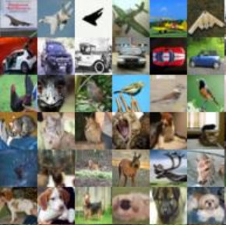
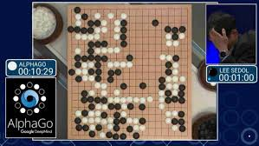
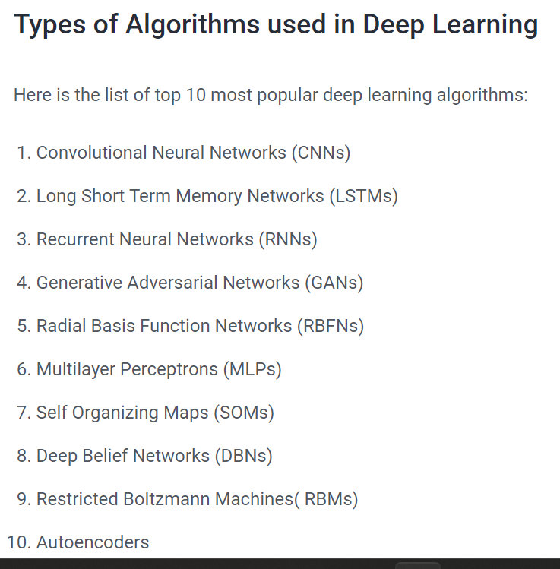
Deep learning
AlexNet (2012): huge gains in object recognition; transformed computer vision community overnight
AlphaGo (2016): deep reinforcement learning, world champion Lee Sedol
Notes:
The real break for neural networks came in the 2010s. With the rise of compute (notably GPUs) and large datasets such as ImageNet (2009), the time was ripe for the world to take note of neural networks.
AlexNet was a pivotal system that showed the promise of deep convolutional networks on ImageNet, the benchmark created by the computer vision community who was at the time still skeptical of deep learning. Many other success stories in speech recognition and machine translation followed.

Slide 47
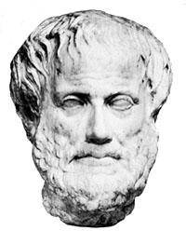
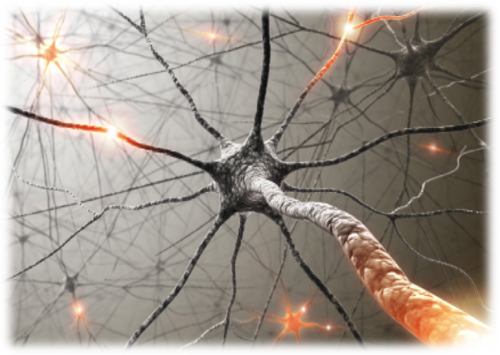
Two intellectual traditions
AI has always swung back and forth between the two
Deep philosophical differences, but deeper connections (McCulloch/Pitts, AlphaGo)?
Logic
Neuroscience
Notes:
Reflecting back on the past of AI, there have been two intellectual traditions that have dominated the scene: one rooted in logic and one rooted in neuroscience (at least initially). This debate is paralleled in cognitive science with connectionism and computationalism.
While there are deep philosophical differences, perhaps there are deeper connections.
For example, McCulloch and Pitts’ work from 1943 can be viewed as the root of deep learning, but that paper is mostly about how to implement logical operations.
The game of Go (and indeed, many games) can be perfectly characterized by a set of simple logic rules. At the same time, the most successful systems (AlphaGo) do not tackle the problem directly using logic, but appeal to the fuzzier world of artificial neural networks.

Slide 48
A melting pot
Bayes rule (Bayes, 1763) from probability
Least squares regression (Gauss, 1795) from astronomy
First-order logic (Frege, 1893) from logic
Maximum likelihood (Fisher, 1922) from statistics
Artificial neural networks (McCulloch/Pitts, 1943) from neuroscience
Minimax games (von Neumann, 1944) from economics
Stochastic gradient descent (Robbins/Monro, 1951) from optimization
Uniform cost search (Dijkstra, 1956) from algorithms
Value iteration (Bellman, 1957) from control theory
Notes:
Of course, any story is incomplete.
In fact, for much of the 1990s and 2000s, neural networks were not popular in the machine learning community, and the field was dominated more by techniques such as Support Vector Machines (SVMs) inspired by statistical theory.
The fuller picture is that the modern world of AI is more like New York City—it is a melting pot that has drawn from many different fields ranging from statistics, algorithms, economics, etc.
And often it is the new connections between these fields that are made and their application to important
real-world problems that makes working on AI so rewarding.

Slide 49
Perspective towards Artificial Intelligence.

Slide 50
Perspective for AI?
Thinking humanly
Acting Rationally
Thinking Rationally
Acting Humanly
Thought/
Reasoning
Behavior/
Actions
Human-like
Intelligence
“Ideal” Intelligent/
Rationally
Notes:
A system is intelligent if it does the right thing given what it knows.

Slide 51
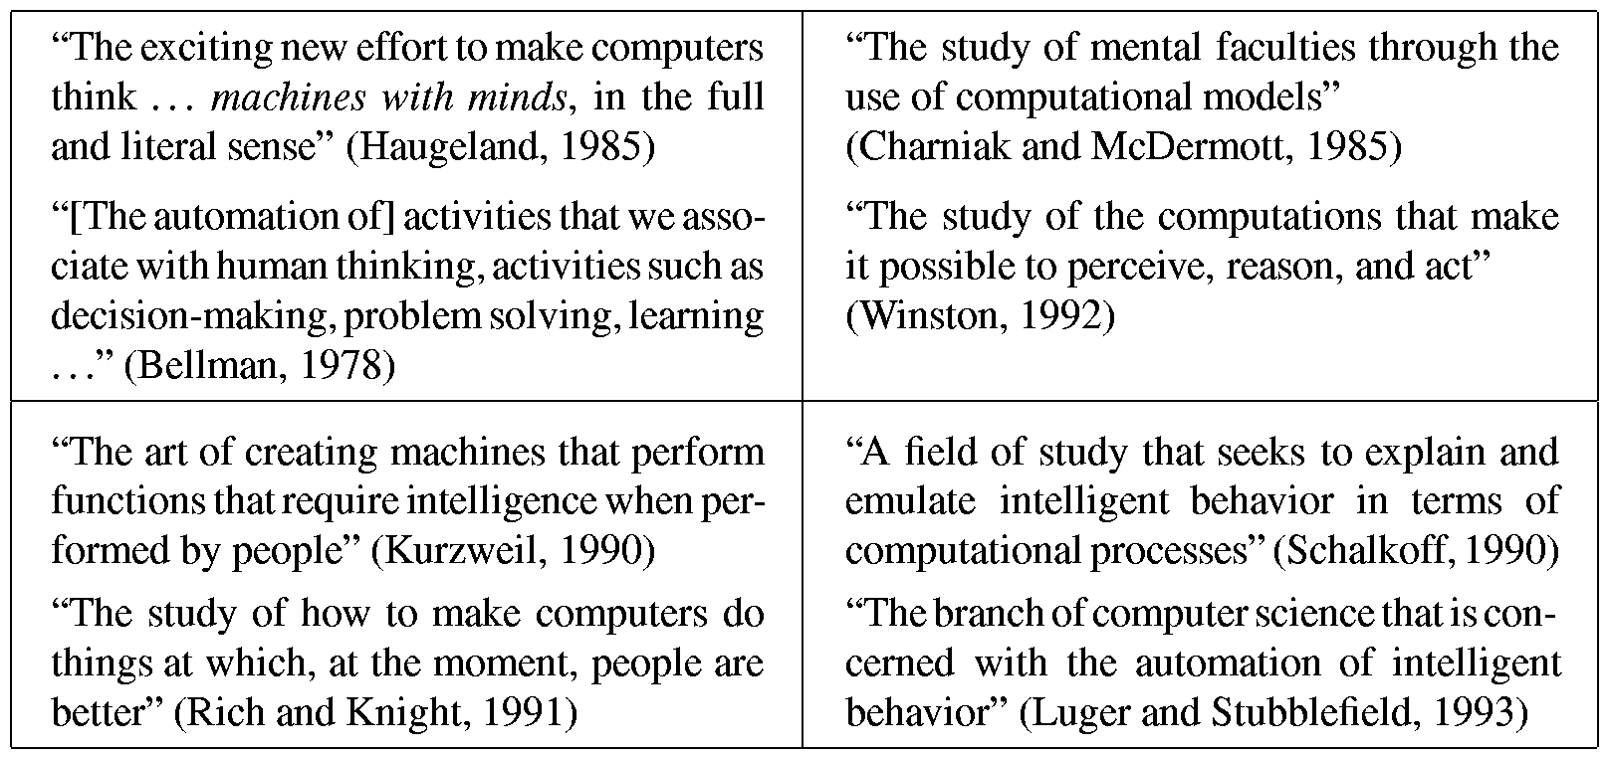
Different AI Perspectives
Human Thinking
Human Acting
Rational Thinking
Rational Acting
2. Systems that think like humans
3. Systems that think rationally
1. Systems that act like humans
4. Systems that act rationally

Slide 52
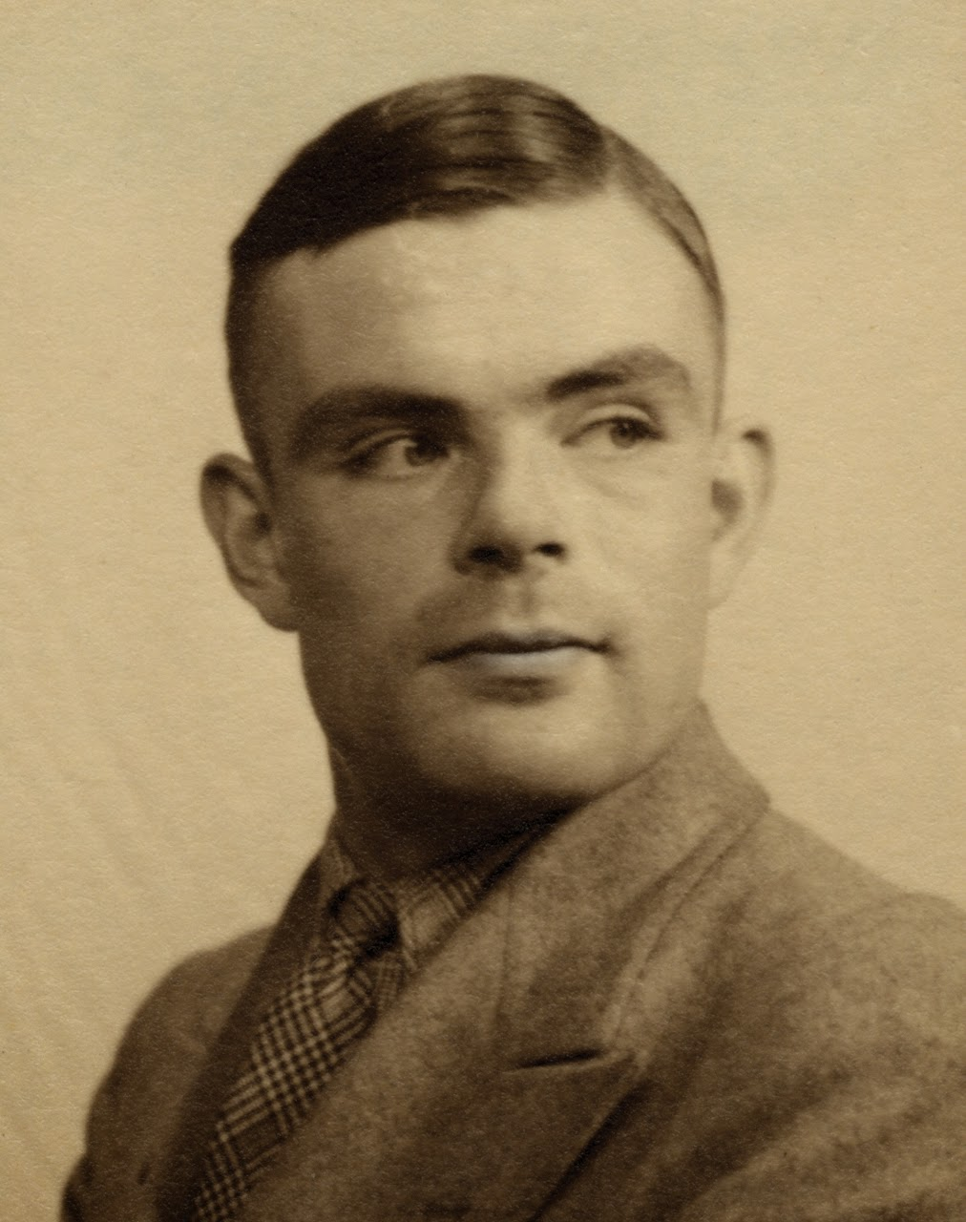
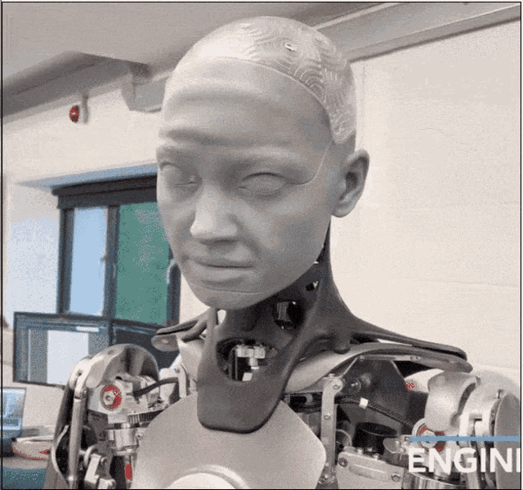
Acting Humanly
In 1936, Alan Turing, a British mathematician, showed that there exists a relatively simple universal computing device that can perform any computational process.
Computers use such a universal model.
Turing also showed the limits of computation – some problems cannot be computed even with the most powerful computer and even with unlimited amount of time – e.g., Halting problem.
Alan Turing

Slide 53
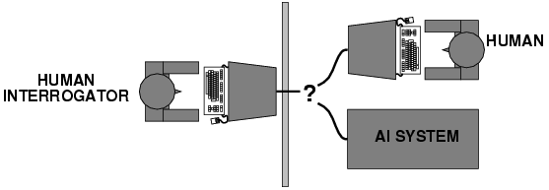
Acting Humanly
Turing (1950) "Computing machinery and intelligence":
"Can machines think?“ Instead, "Can machines behave intelligently?"
Operational test for intelligent behavior: the Imitation Game
Predicted that by 2000, a machine might have a 30% chance of fooling a lay person for 5 minutes
Anticipated all major arguments against AI in following 50 years
Suggested major components of AI
AI system passes
if interrogator
cannot tell which one is the machine
(interaction via written questions)

Slide 54
Acting Humanly
Natural Language Processing – to communicate with the machine;
Knowledge Representation – to store and manipulate information;
Automated reasoning – to use the stored information to answer questions and draw new conclusions;
Machine Learning – to adapt to new circumstances and to detect and extrapolate patterns.
but does a machine need to act humanly
to be considered intelligent?

Slide 55
Thinking Humanly
Requires scientific theories of internal activities of the brain;
Cognitive Science (top-down) : computer models + experimental techniques from psychology
  → Predicting and testing behavior of human subjects
Cognitive Neuroscience (bottom-up)
  → Direct identification from neurological data

Slide 56
Thinking Rationally
Logic → Making the right inferences! Several Greek schools developed various forms of logic: notation and rules of derivation for thoughts;
Aristotle: what are correct arguments/thought processes? (characterization of “right thinking”);
More contemporary logicians (e.g. Boole, Frege, Tarski) →
Direct line through mathematics and philosophy to modern A

Slide 57
Thinking Rationally
Socrates is a man
All men are mortal
-------------------------
Therefore Socrates is mortal
Limitations:
  Not all intelligent behavior is mediated by logical deliberation
  What is the purpose of thinking? What thoughts should I have?

Slide 58
Acting Rationally
Rational behavior: doing the right thing
The right thing: that which is expected to maximize goal achievement, given the available information
Doesn't necessarily involve thinking – e.g., blinking reflex – but thinking should be in the service of rational action

Slide 59
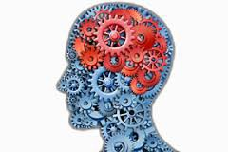
Rational Agent
Robotics
Language
Perception
Knowledge
Reasoning
Learning
Notes:
The starting point for the agent-based view is ourselves.
As humans, we have to be able to perceive the world (computer vision), perform actions in it (robotics), and communicate with other agents (language).
We also have knowledge about the world (from procedural knowledge like how to ride a bike, to declarative knowledge like remembering the capital of France), and using this knowledge we can draw inferences and make decisions (reasoning).
Finally, we learn and adapt over time. We are born with none of the skills that we possess as adults, but rather the capacity to acquire them. Indeed machine learning has become the primary driver of many of the AI applications we see today.

Slide 60
Environments for Agents
Fully observable
Accessible
Discrete
Static
Episodic
Deterministic
Single agent

Slide 61


Two Views towards Rational Approach
AI agents: achieving human-level intelligence, still very far (e.g., generalize from few examples)
AI Tools: need to think carefully about real-world consequences (e.g., security, biases)

Slide 62
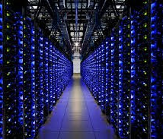

Are we there yet?
Machines: narrow tasks, millions of examples
Humans: diverse tasks, very few examples
Notes:
The AI agents view is an inspiring quest to undercover the mysteries of intelligence and tackle the tasks that humans are good at. While there has been a lot of progress, we still have a long way to go along some dimensions: for example, the ability to learn quickly from few examples or the ability to perform commonsense reasoning.
There is still a huge gap between the regimes that humans and machines operate in. For example, AlphaGo learned from 19.6 million games, but can only do one thing: play Go. Humans on the other hand learn from a much wider set of experiences, and can do many things.

Slide 63
AI Tools
Saving energy by cooling datacenters
Predicting poverty
Helping in the invigilation of students in exam hall, elderly persons, toddlers, pets, etc.
Surveillance systems
Notes:
Computer vision techniques, used to recognize objects, can also be used to tackle social problems. Poverty is a huge problem, and even identifying the areas of need is difficult due to the difficulty in getting reliable survey data. Recent work has shown that one can take satellite images (which are readily available) and predict various poverty indicators.

Slide 64
Course Roadmap

Slide 65
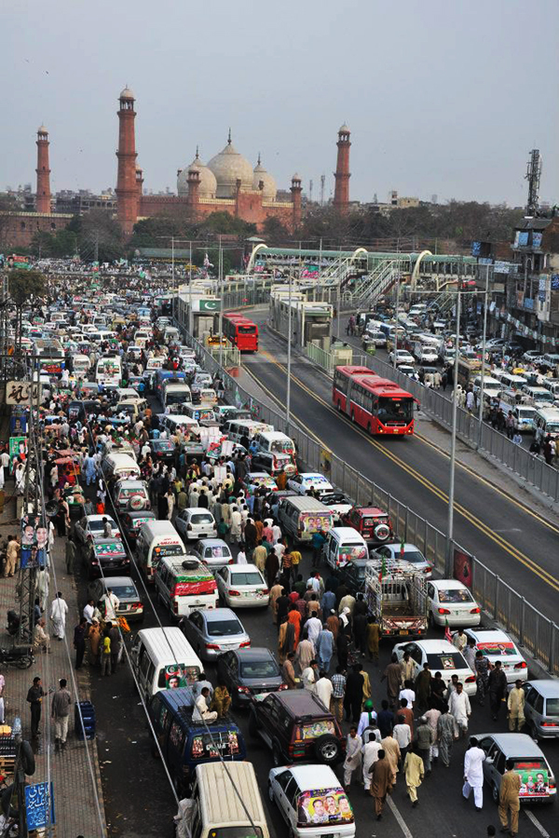

How to Approach towards Solution of AI tasks?

Slide 66
Paradigm
Major Pillars
Modeling
Learning
Inference

Slide 67
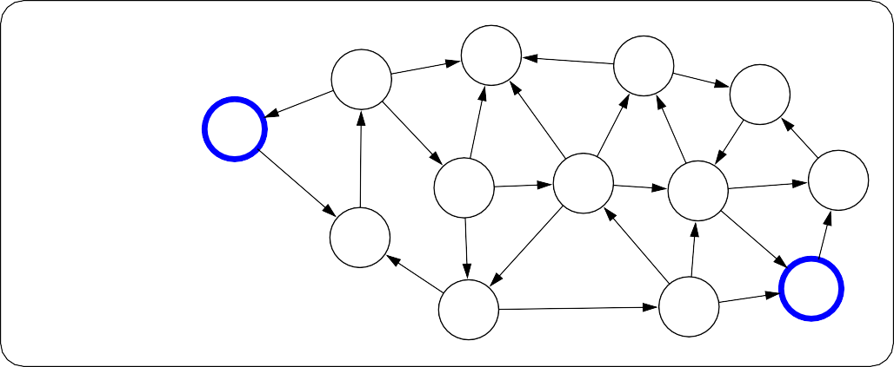
Paradigm
Modeling
A computational model contains numerous variables that characterize the system being studied
Important info
to figure out the
problem solution
e.g. for vehicle number
Plates?
Real world
6
7
4
5
5
5
3
1
Model
0
8
6
3
8
8
1
1
7
2
3
6
7
2
4
8
6
Notes:
The first pillar is modeling. Modeling takes messy real world problems and packages them into neat formal mathematical objects called models, which can be subject to rigorous analysis and can be operated on by computers. However, modeling is lossy: not all of the richness of the real world can be captured, and therefore there is an art of modeling: what does one keep versus ignore? (An exception to this are games such as Chess, Go or Sodoku, where the real world is identical to the model.)
As an example, suppose we’re trying to have an AI that can navigate through a busy city. We might formulate this as a graph where nodes represent points in the city, edges represent the roads, and the cost of an edge represents the traffic on that road.

Slide 68

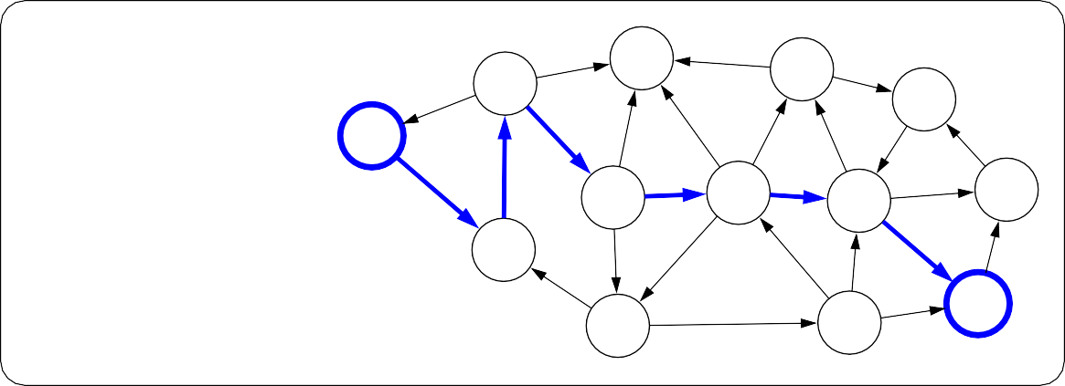
Paradigm
Inference
6
7
4
5
5
5
3
1
Model
0
8
6
3
8
8
1
1
7
2
3
6
7
2
4
8
6
Inference
Getting new info by putting questions
6
7
4
5
8
5
5
3
1
Predictions
0
6
3
8
8
1
1
7
2
3
6
7
2
4
8
6
Notes:
The second pillar is inference. Given a model, the task of inference is to answer questions with respect to the model. For example, given the model of the city, one could ask questions such as: what is the shortest path? what is the cheapest path?
The focus of inference is usually on efficient algorithms that can answer these questions. For some models, computational complexity can be a concern (games such as Go), and usually approximations are needed.

Slide 69
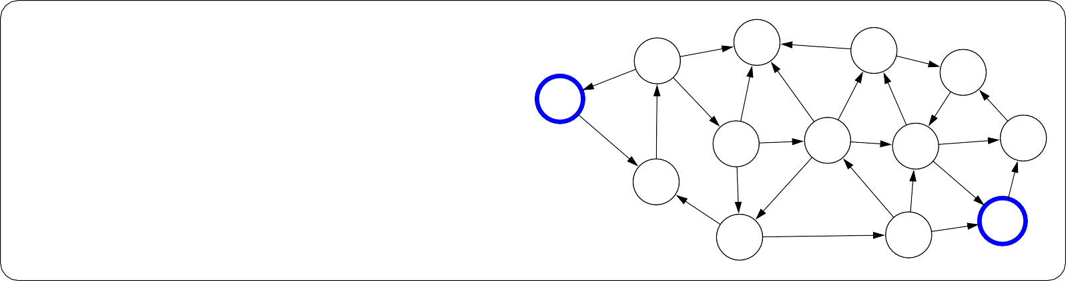
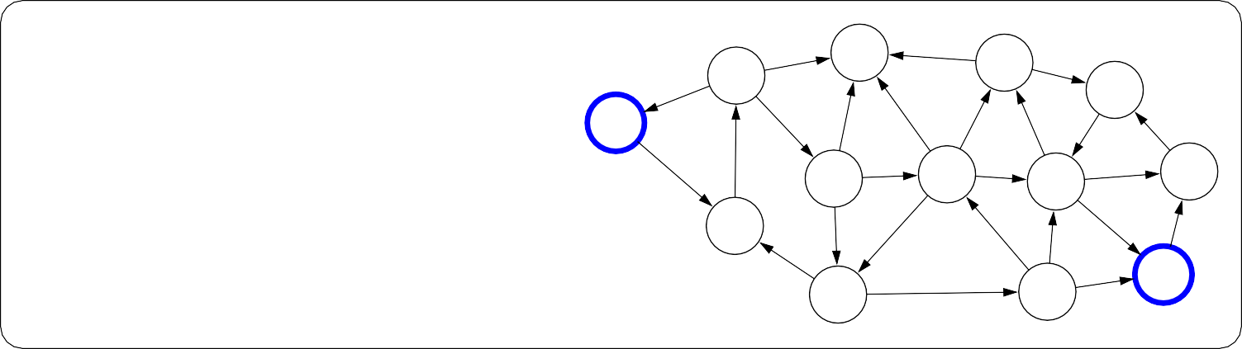
Paradigm
Learning
?
?
?
?
?
?
?
?
Model without parameters
?
?
?
?
+ Data
?
?
?
?
?
?
?
?
?
?
?
?
?
Learning
6
7
4
5
5
5
3
1
Model with parameters
0
8
6
3
8
8
1
1
7
2
3
6
7
2
4
8
6
Notes:
But where does the model come from? Remember that the real world is rich, so if the model is to be faithful, the model has to be rich as well. But we can’t possibly write down such a rich model manually.
The idea behind (machine) learning is to instead get it from data. Instead of constructing a model, one constructs a skeleton of a model (more precisely, a model family), which is a model without parameters. And then if we have the right type of data, we can run a machine learning algorithm to tune the parameters of the model.
Note that learning here is not tied to a particular approach (e.g., neural networks), but more of a philosophy.
This general paradigm will allow us to bridge the gap between logic-based AI and statistical AI.

Slide 70
Course Plan
Low Level Intelligence
High Level Intelligence
Artificial Intelligence
Notes:
We now embark on our tour of the topics in this course. The topics correspond to types of models that we can use to represent real-world tasks. The topics will in a sense advance from low-level intelligence to high-level intelligence, evolving from models that simply make a reflex decision to models that are based on logical reasoning.

Slide 71
Machine Learning
The main driver of recent successes in AI
Move from ”code” to ”data” to manage the information complexity
Requires a leap of faith: generalization
Data
Model
Notes:
Supporting all of these models is machine learning, which has been arguably the most crucial ingredient powering recent successes in AI. From a systems engineering perspective, machine learning allows us to shift the information complexity of the model from code to data, which is much easier to obtain (either naturally occurring or via crowdsourcing).
The main conceptually magical part of learning is that if done properly, the trained model will be able to produce good predictions beyond the set of training examples. This leap of faith is called generalization, and is, explicitly or implicitly, at the heart of any machine learning algorithm. This can even be formalized using tools from probability and statistical learning theory.

Slide 72
Course Plan
Reflex
Low Level Intelligence
High Level Intelligence
Artificial Intelligence
Notes:
We now embark on our tour of the topics in this course. The topics correspond to types of models that we can use to represent real-world tasks. The topics will in a sense advance from low-level intelligence to high-level intelligence, evolving from models that simply make a reflex decision to models that are based on logical reasoning.

Slide 73
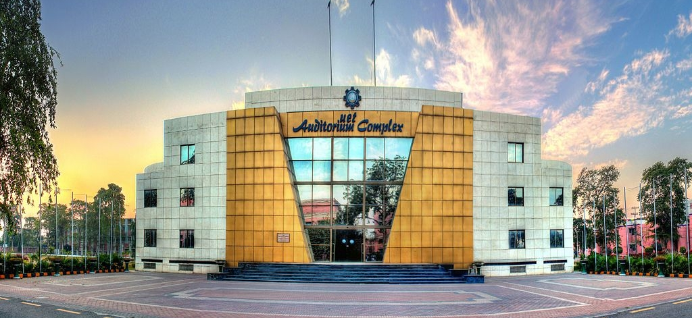
What is this building?

Slide 74


Reflex Based Models
Examples: linear classifiers, deep neural networks
Most common models in machine learning
Fully feed-forward (no backtracking)
They require
Minimum variables

Slide 75
Course Plan
Little more intelligence is required
Search problems
Markov decision processes
Adversarial games
Reflex
States
Low Level Intelligence
High Level Intelligence
Artificial Intelligence
Notes:
We now embark on our tour of the topics in this course. The topics correspond to types of models that we can use to represent real-world tasks. The topics will in a sense advance from low-level intelligence to high-level intelligence, evolving from models that simply make a reflex decision to models that are based on logical reasoning.

Slide 76


State Based Models
Applications:
Games: Chess, Go, Pac-Man, Starcraft, etc.
Robotics: motion planning
Natural language generation: machine translation, image captioning, Chat GPT
White to move
Notes:
Reflex-based models are too simple for tasks that require more forethought (e.g., in playing chess or planning a big trip). State-based models overcome this limitation.
The key idea is, at a high-level, to model the state of a world and transitions between states which are triggered by actions. Concretely, one can think of states as nodes in a graph and transitions as edges. This reduction is useful because we understand graphs well and have a lot of efficient algorithms for operating on graphs.

Slide 77


State Based Models
Search problems: you control everything
Markov decision processes: against nature (e.g., Blackjack)
outcomes are partly random and partly controllable.
Adversarial games: against opponent (e.g., chess)
Notes:
Search problems are adequate models when you are operating in an environment that has no uncertainty. However, in many realistic settings, there are other forces at play.
Markov decision processes handle tasks with an element of chance (e.g., Blackjack), where the distri- bution of randomness is known (reinforcement learning can be employed if it is not).
Adversarial games, as the name suggests, handle tasks where there is an opponent who is working against you (e.g., chess).

Slide 78

Pac-Man

Slide 79
Course Plan
Search problems
Markov decision processes
Adversarial games
Constraint satisfaction problems
Bayesian networks
Reflex
States
Variables
Multi-modalities
Really not state based
problems
Low Level Intelligence
High Level Intelligence
Artificial Intelligence
Notes:
We now embark on our tour of the topics in this course. The topics correspond to types of models that we can use to represent real-world tasks. The topics will in a sense advance from low-level intelligence to high-level intelligence, evolving from models that simply make a reflex decision to models that are based on logical reasoning.

Slide 80






Sudoku
Goal: put digits in blank squares so each row, column, and 3x3 sub-block has digits 1–9
Note: order of filling squares doesn’t matter in the evaluation criteria!
Notes:
In state-based models, solutions are procedural: they specify step by step instructions on how to go from A to B. In many applications, the order in which things are done isn’t important.

Slide 81
Variable-based models
Constraint scheduling)
satisfaction problems: hard constraints
(e.g.,
Sudoku,
X₁
X₂
X₃ X₄
Bayesian networks: soft dependencies (e.g., tracking cars from sensors)
H₁ H₂ H₃ H₄ H₅
E₁
E₂
E₃
E₄
E₅
Notes:
Constraint satisfaction problems are variable-based models where we only have hard constraints. For example, in scheduling, we can’t have two people in the same place at the same time.
Bayesian networks are variable-based models where variables are random variables which are dependent on each other. For example, the true location of an airplane H_{t} and its radar reading E_{t} are related, as are the location H_{t} and the location at the last time step H_{t−1}. The exact dependency structure is given by the graph structure and it formally defines a joint probability distribution over all of the variables. This topic is studied thoroughly in probabilistic graphical models (CS228).

Slide 82
Course Plan
Search problems
Markov decision processes
Adversarial games
Constraint satisfaction problems
Bayesian networks
Reflex
States
Variables
Logic
Low Level Intelligence
High Level Intelligence
Artificial Intelligence

Slide 83


Motivation: Virtual Assistant
Tell information
Ask questions
Use natural language!
[demo]
Need to:
Digest heterogenous information
Reason deeply with that information
Notes:
Our last stop on the tour is logic. Even more so than variable-based models, logic provides a compact language for modeling which gives us more expressivity.
It is interesting that historically, logic was one of the first things that AI researchers started with in the 1950s. While logical approaches were in a way quite sophisticated, they did not work well on complex real-world tasks with noise and uncertainty. On the other hand, methods based on probability and machine learning naturally handle noise and uncertainty, which is why they presently dominate the AI landscape. However, they are yet to be applied successfully to tasks that require really sophisticated reasoning.
In this course, we will appreciate the two as not contradictory, but simply tackling different aspects of
AI — in fact, in our course plan, logic is a class of models which can be supported by machine learning. An active area of research is to combine the richness of logic with the robustness and agility of machine learning.
One motivation for logic is a virtual assistant. At an abstract level, one fundamental thing a good personal assistant should be able to do is to take in information from people and be able to answer questions that require drawing inferences from these facts.
In some sense, telling the system information is like machine learning, but it feels like a very different form of learning than seeing 10M images and their labels or 10M sentences and their translations. The type of information we get here is both more heterogenous, more abstract, and the expectation is that we process it more deeply (we don’t want to tell our personal assistant 100 times that we prefer morning meetings).
And how do we interact with our personal assistants? Let’s use natural language, the very tool that was built for communication!

Slide 84
Course Logistics

Slide 85
TENTATIVE LECTURE PLAN
TENTATIVE LECTURE PLAN
Week | Content
Week 01 | Course Overview History of AI Perspective towards AI Course Roadmap Course Logistics
Week 02 | Problem Reduction Methods Dynamic Programming Optimizations Discrete Optimization(Edit Distances) Continuous Optimization(Gradient Descent on single variable)
Week 03 | Search Tree Search Depth-First, Breadth-First Hill climbing, Beam Dynamic Programming
Week 04 | Uniform Cost Search A*, Heuristic Search

Slide 86
TENTATIVE LECTURE PLAN
Week 05 | Machine Learning Unsupervised Learning Kmeans Game Theory Minimax alpha-beta and Progressive Deepening Search
Week 06 | Constraint Satisfaction Problems Interpretation Line Drawings, Search and Domain Reduction
Week 07 | Constraint Satisfaction Problems Constraints Visual Object Recognition
Week 08 | Bayesian Networks Hidden Markov Models
Week 09 | Mid Term Week
Week 10 | Logic: First Order Logic

Slide 87
TENTATIVE LECTURE PLAN
Week 11 | Machine Learning Linear Classification Loss Minimization Stochastic Gradient Descent
Week 12 | Machine Learning Features Non-Linearity Neural Networks
Week 13 | Machine Learning Nearest Neighbours ID Trees
Week 14 | Deep Learning Autoencoders CNN
Week 15 | Deep Learning RNN
Week 16 | Final Term

Slide 88

Textbook
Artificial Intelligence: A Modern Approach by Russell

Slide 89
GRADED COURSE COMPONENTS
Text Book Exercises
Selective exercises released on Eduko to check your understanding of lecture material
Problem Set (PSet):
More involved questions that apply lecture concepts (algorithm design questions, proofs)
Exams
Mid Term and Final Term Exam
Projects
Projects to apply concepts on real world
Quizzes
Short quizzes.
Format may vary

Slide 90




COURSE GRADING POLICY
Exam
50%
Projects
25%
Quizzes
15%
Problem Sets & Exercises
10%

Slide 91
PLAGIARISM POLICY
Plagiarism implies copying work produced by someone else. Each student is expected to maintain the highest standards of honesty and integrity in academic and professional matters. The University reserves the right to take disciplinary action, including dismissal, against any student who is found responsible for academic dishonesty. Any student who has been judged to have engaged in academic dishonesty in course work may receive a reduced or failing grade for the work in question and/or for the course. Academic dishonesty includes, but is not limited to, dishonesty in quizzes, tests or assignments; claiming credit for work not done or done by others; hindering the academic work of other students; and misrepresenting academic or professional qualifications within or outside the University.

Slide 92
OTHER COURSE POLICIES
All course policy details are listed in course outline
Some important policies to mention:
  Homework collaboration policy
  Late problem set policy
  Regrade policy

Slide 93
COURSE FEEDBACK
We’re always trying to evolve this class, so please leave us feedback!.
We’ll also have feedback surveys at the end of each homework that ask about more specific aspects of the course.

Slide 94
PERSONAL SUPPORT
If you ever feel overwhelmed with university, your work, your home, your health, your family, world concerns, community concerns, the general state of the world, etc., please don’t hesitate to reach out. We want to support you both as a student working to succeed in this course and as a person trying to make it through everything that life hurls at us. We’re here for you if you need to talk, find resources, figure out what it is you even need, or really anything at all. You can find us on email.

Slide 95
Problem Reductions

Slide 96
Problem Reduction Methods
Goal centric
Divides into sub-problems/sub-goals
Goal reduction methods
Answers
  How?
  Why?

Slide 97
Examples
Factorial
Blocks Handling
Integration

Slide 98
Factorial Python Recursive Code
def recur_factorial(n):
if n == 1:
return n
else:
return n*recur_factorial(n-1)

Slide 99
Fibonacci Python – Recursive Code
# Python program to display the Fibonacci sequence
def rec_fib(n):
if n <= 1:
return n
else:
return(rec_fib(n-1) + rec_fib(n-2)

Slide 100

Notes:
https://www.google.com/url?sa=i&url=http%3A%2F%2Fwww.math.bas.bg%2F~nkirov%2F2004%2FHorstman%2Fch14%2Fch14.html&psig=AOvVaw2OwdFMlZwGWsW8wFWmDGwY&ust=1602580587217000&source=images&cd=vfe&ved=0CAMQjB1qFwoTCMjA9IbbruwCFQAAAAAdAAAAABAJ

Slide 101
Blocks: Demonstration

Slide 102
Blocks: Sub-problems
MOVER – block manipulation and answers questions
PUT <B1> ON <B2> - place one block on top of another block, activates other procedures – find specific place on top of the target block, grasping, moving and ungrasping.
GET-SPACE – finds space on the top of a target block
MAKESPACE – creates room for a travelling block
GRASP – arrange to clear off the top of the object to be grasped
CLEAR-TOP – getting rid of everything on top of the object to be grasped
GET-RID-OF – gets rid of an obstructing object by putting it on table
UNGRASP – let go of whatever it is holding
MOVE – moves objects

Slide 103


Slide 104

MOVER
Mover is a procedure for planning motion sequences in the world of bricks, pyramids, balls, and of a robot hand

Slide 105
COMMAND
PUT BLOCK A ON BLOCK B

Slide 106
COMMAND – PUT BLOCK A ON BLOCK B
GRASP D
MOVE D TO SOME LOCATION ON THE TABLE
UNGRASP D
GRASP C
MOVE C TO SOME LOCATION ON THE TABLE
UNGRASP C
GRASP A
MOVE A TO SOME LOCATON ON B
UNGRASP A

Slide 107
Question: HOW?
How do the procedures in MOVER find the appropriate sequence?

Slide 108
Answer: HOW?
How do the procedures in MOVER find the appropriate sequence?
PUT-ON asks GET-SPACE to identify a place for block A on top of block B
GET-SPACE appeals to MAKE-SPACE because block D is in the way.
MAKE-SPACE asks GET-RID-OF to help by getting rid of block D
GET-RID-OF obliges by finding a place for block D on the table and by moving block D to that place using PUT-ON – new job PUT D on the table (RECURSION)

Slide 109
Answer: HOW?
How do the procedures in MOVER find the appropriate sequence?
With block D gone, MAKE-SPACE can find a place for block A to go on top of block B
MAKE-SPACE was asked by GET-SPACE (to put A on B)
PUT-ON ask GRASP for a. PUT-ON cannot grasp A because C is in the way.
GRASP ASKS FOR CLEAR-TOP
CLEAR-TOP asks GET-RID-OF
GET-RID-OF arranges for block C to go on table using PUT-ON
CLEAR-TOP finished as block A is cleared.

Slide 110
Answer: HOW?
How do the procedures in MOVER find the appropriate sequence?
CLEAR-TOP finished as block A is cleared.
GRASP can now do its job
PUT-ON can ask MOVE to move block A to the place found previously on top of block B.
PUT-ON asks UNGRASP to let block A go.

Slide 111

Key Idea in Problem Reduction – Goal Tree
A semantic tree is a semantic net with special links, called branches each of which connects two nodes.
A semantic tree is a representation
Links are called braches
Head node – parent node
Tail node – child node
If node has no parent then it is called root node
Node with no children – Leaf nodes
When two nodes are connected to each other by a chain of two or more branches, one is said to be the ancestor; the other is said to be the descendant

Slide 112
Goal Tree
Constructors
Connect a parent node to a child node with a branch link
Readers
Produce a list of a given node’s children
Produce a given node’s parent

Slide 113

What is goal tree?
A goal tree, is a semantic tree in which nodes represent goals and branches indicate how you can achieve goals by solving one or more subgoals.
Each node’s children correspond to immediate subgoals; each node’s parent corresponds to the immediate subgoals.

Slide 114

Goal Tree – Transparent Procedures
Goals that are satisfied only when all of their immediate subgoals are satisfied
Goals that are satisfied only when all of their immediate subgoals are satisfied are called AND goals and corresponding nodes are called AND nodes.
Arcs are placed on the branches of AND nodes.
OR goals are satisfied when any of their immediate subgoals are satisfied.
Unmarked nodes are called OR nodes.
Leaf goals – no subgoals and corresponding nodes are called leaf nodes.
Goal trees are also called AND-OR Trees

Slide 115



Test – How goal is achieved?
REDUCE
  REDUCE- AND
  REDUCE-OR

Slide 116
Introspective Question Answering
Problem: PUT BLOCK A ON BLOCK B
Questions:
Q: How did you clear the top of A?
Ans: By getting rid of block C
Q: Why did you clear the top of A?
Ans: To grasp block A
HOW?
You identify goal involved in AND-OR tree
If goal is an AND goal, report all immediate subgoals.
If goal is an OR goal, report immediate subgoal that was achieved
Why?
Identify the goal and report the immediate super-goal
Why?
How?

Slide 117
Optimization Problems

Slide 118

Optimizations
Discrete optimization: find the best discrete object
$$\min_{p ∈Paths}{Cost(p)}$$
Algorithmic tool: Dynamic Programming
Continuous optimization: find the best vector of real numbers
$$\min_{w ∈R^{d}}{TrainingError(w)}$$
Algorithmic tool: Gradient Descent
Notes:
We are now done with the high-level motivation for the class. Let us now dive into some technical details. Let us focus on the inference and the learning aspect of the modeling-inference-learning paradigm.
We will approach inference and learning from an optimization perspective, which allows us to decouple the mathematical specification of what we want to compute from the algorithms for how to compute it.
In total generality, optimization problems ask that you find the x that lives in a constraint set C that
makes the function F (x) as small as possible.
There are two types of optimization problems we’ll consider: discrete optimization problems (mostly for inference) and continuous optimization problems (mostly for learning). Both are backed by a rich research field and are interesting topics in their own right. For this course, we will use the most basic tools from these topics: dynamic programming and gradient descent.
Let us do two practice problems to illustrate each tool. For now, we are assuming that the model (opti- mization problem) is given and only focus on algorithms.

Slide 119

Problem: Computing Edit Distance
Input: two strings, s and t
Output: minimum number of character insertions, deletions, and substitutions it takes to change s into t
Examples:
”cat”, ”cat” | ⇒ | 0
”cat”, ”dog” | ⇒ | 3
”cat”, ”at” | ⇒ | 1
”cat”, ”cats” | ⇒ | 1
”a cat!”, ”the cats!” | ⇒ | 4
Notes:
Let’s consider the formal task of computing the edit distance (or more precisely the Levenshtein dis- tance) between two strings. These measures of dissimilarity have applications in spelling correction and computational biology (applied to DNA sequences).
As a first step, you should think of breaking down the problem into subproblems. Observation 1: inserting into s is equivalent to deleting a letter from t (ensures subproblems get smaller). Observation 2: perform edits at the end of strings (might as well start there).
Consider the last letter of s and t. If these are the same, then we don’t need to edit these letters, and we can proceed to the second-to-last letters. If they are different, then we have three choices. (i) We can substitute the last letter of s with the last letter of t. (ii) We can delete the last letter of s. (iii) We can insert the last letter of t at the end of s.
In each of those cases, we can reduce the problem into a smaller problem, but which one? We simply try
all of them and take the one that yields the minimum cost!
We can express this more formally with a mathematical recurrence. These types of recurrences will show up throughout the course, so it’s a good idea to be comfortable with them. Before writing down the actual recurrence, the first step is to express the quantity that we wish to compute. In this case: let

Slide 120
Solution
def distance(a,b,n,m):
if a or b is empty:
return length of non-empty string
else if last character is same:
return distance(a,b,n-1,m-1)
else:
find c1 cost of substitution
find c2 cost of deletion
find c3 cost of addition
return min(c1,c2,c3)

Slide 121

Solution
Example:
distance(x, xy, 1, 2)

Slide 122


Problem: Finding the Least Square Lines
Input: set of pairs {(x₁, y₁), . . . , (x_{n}, y_{n})}
Output: $w∈R$that minimizes the squared error
$$F\left(w\right)= \sum_{i=1}^{n}{{\left(x_{i}w −y_{i}\right)}^{2}}$$
Examples:
{(2, 4)} | ⇒ | 2
{(2, 4), (4, 2)} | ⇒ | ?
Notes:
The formal task is this: given a set of n two-dimensional points (x_{i}, y_{i}) which defines F (w), compute the
w that minimizes F (w).
Linear regression is an important problem in machine learning, which we will come to later. Here’s a motivation for the problem: suppose you’re trying to understand how your exam score (y) depends on the number of hours you study (x). Let’s posit a linear relationship y = wx (not exactly true in practice, but maybe good enough). Now we get a set of training examples, each of which is a (x_{i}, y_{i}) pair. The goal is to find the slope w that best fits the data.
Back to algorithms for this formal task. We would like an algorithm for optimizing general types of F (w). So let’s abstract away from the details. Start at a guess of w (say w = 0), and then iteratively update w based on the derivative (gradient if w is a vector) of F (w). The algorithm we will use is called gradient descent.
If the derivative F^{t}(w) < 0, then increase w; if F^{t}(w) > 0, decrease w; otherwise, keep w still. This
motivates the following update rule, which we perform over and over again: w ← w − ηF^{t}(w), where
η > 0 is a step size that controls how aggressively we change w.
If η is too big, then w might bounce around and not converge. If η is too small, then w might not move very far to the optimum. Choosing the right value of η can be rather tricky. Theory can give rough guidance, but this is outside the scope of this class. Empirically, we will just try a few values and see which one works best. This will help us develop some intuition in the process.
Now to specialize to our function, we just need to compute the derivative, which is an elementary calculus

Slide 123

Solution

